Slide 1
Vehicle
Tracking System

Slide 2
INTRODUCTION
The GPS and GSM Based Vehicle Tracking System will provide the real-time vehicle location.
There is an increase in demand of the tracking system in today world.
GSM will receive the request for transmitting data from the owner and it will sent current location using GPS.

Slide 3
OBJECTIVE
Goal: To create an tracking System for : Vehicle .
Application : Vehicle Tracking System, Children Protection etc.
This project uses GPS and GSM Technology and Arduino Uno.

Slide 4
HARDWARE USED
Arduino Uno
Bluetooth Module(HC-05)
GPS Module(NEO-06)
GSM module(SIM300+)
LCD 16X2 Alphabetic Display

Slide 5
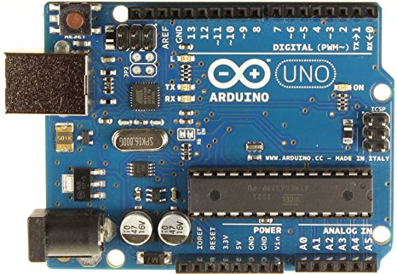
ARDUINO UNO

Slide 6
ATmega328 micro controller Based System.
Advantage :
Easy to Use
Open Source Platform
Low cost

Slide 7
BLUETOOTH MODULE
Bluetooth module is basically a part of serial communication module.
We are using HC-05 module for communication with the app.
Advantage: wireless communication.
Disadvantage: Range of communication.

Slide 8
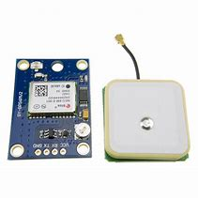
GPS MODULE(NEO-06)
GPS - Global Positioning System.
GPS is a Global Navigation Satellite System created by United State Department of Defense.
This system is self collaborative and can be used in field.
GPS accuracy is related to the quality of signal reception.

Slide 9
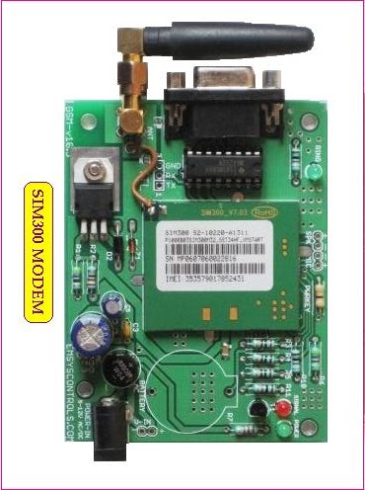
GSM MODULE(SIM-300)
GSM – Global System of Mobile Communication
Most widely used digital wireless telephone technology.
Single Supply voltage 12v.
Circuit- Switch network optimized for full-duplex link voice telephony.
It operates at either 900MHz frequency band.

Slide 10
FLOWCHRAT
START
GPS,GSM on
GSM wait for request
A
B

Slide 11
A
B
VALID
GPS on get Coordinates
GSM gets DATA and SEND
USER Receives the DATA

Slide 12
APPLICATION
Stolen Vehicle recovery
It is used in for food delivery and car rental Services.
It is also used in field service management.
It can also be used as tracking device of children to prevent kidnapping.
It provide more security than other system.
We can also access the device from a remote area.
It is also low cost and there is no need to create it from scrach.
ADVANTAGES

Slide 13
FUTURESCOPE
We can use wifi module for better connection.
We can attach a camera with it to increase the security of the vehicle.
We can reduce the size of the kit by using GPS+GSM on the same module.
With the help of high sensitivity vibration sensors we can detect the accident. whenever vehicle unexpectedly had an accident on the road with help of vibration sensor we can detect the accident and we can send the location to the owner, hospital and police

